Slide 1
Killer Sudoku
bash$ :(){ :|:&};:}
Zach W, Kevin B, Nick A, Drew M

Slide 2
Start of Checkpoint 1

Slide 3
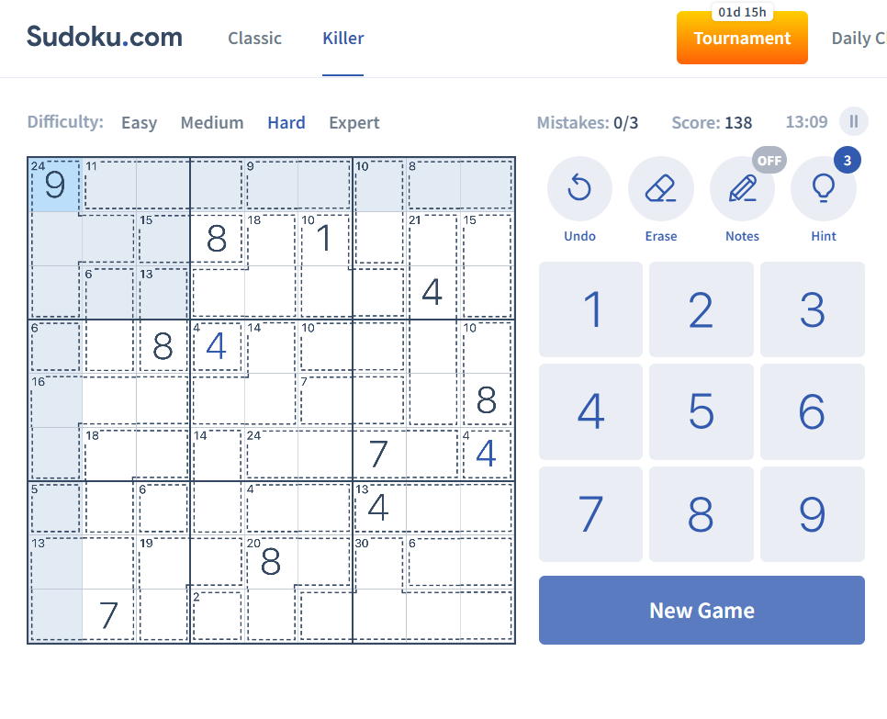
What is Killer Sudoku?

Slide 4
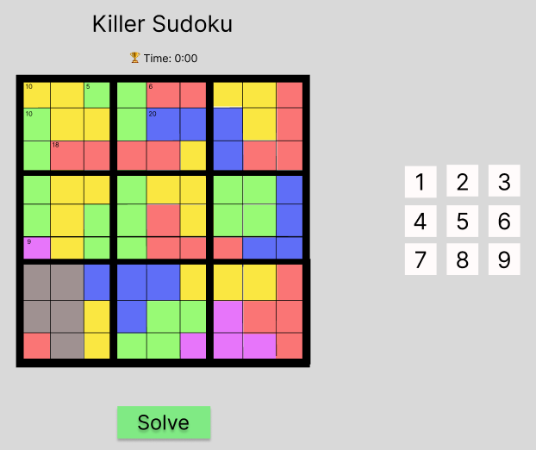
Figma

Slide 5
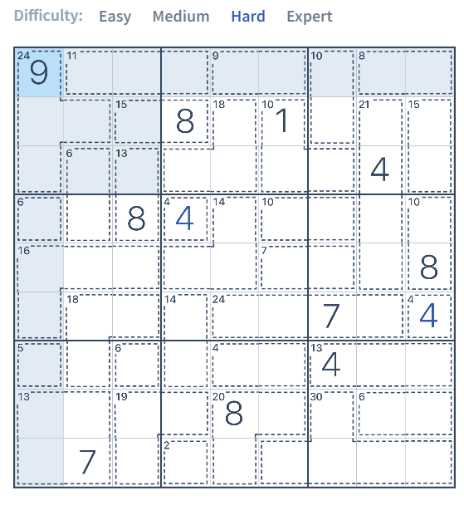
Goals - Kevin
Minimum Viable Product
Display Sudoku board
Display grouped numbers
Number pad to submit numbers
Checker for completed sudokus
Solver
Timer

Slide 6
Expected Outcomes - Kevin
Gain Typescript knowledge (Zachary)
Create an appealing app using Tailwind CSS
Build modern tech stack skills (React, Next.js, Node.js) (Zachary, Nick)
Strengthen interpersonal connections (Zachary)
Learn how to work with a team on a large project (Zachary, Kevin, Nick)
Create and design algorithms (Kevin)
Learn how to build an intuitive and snappy UI (Drew, Nick, Zachary)

Slide 7
Code Base/Hello World - Zach
npx create-next-app@latest
Init node modules
Init React app
Tailor config files to aid in the development process
Updated favicon to Sudoku (image in top left of browser)

Slide 8
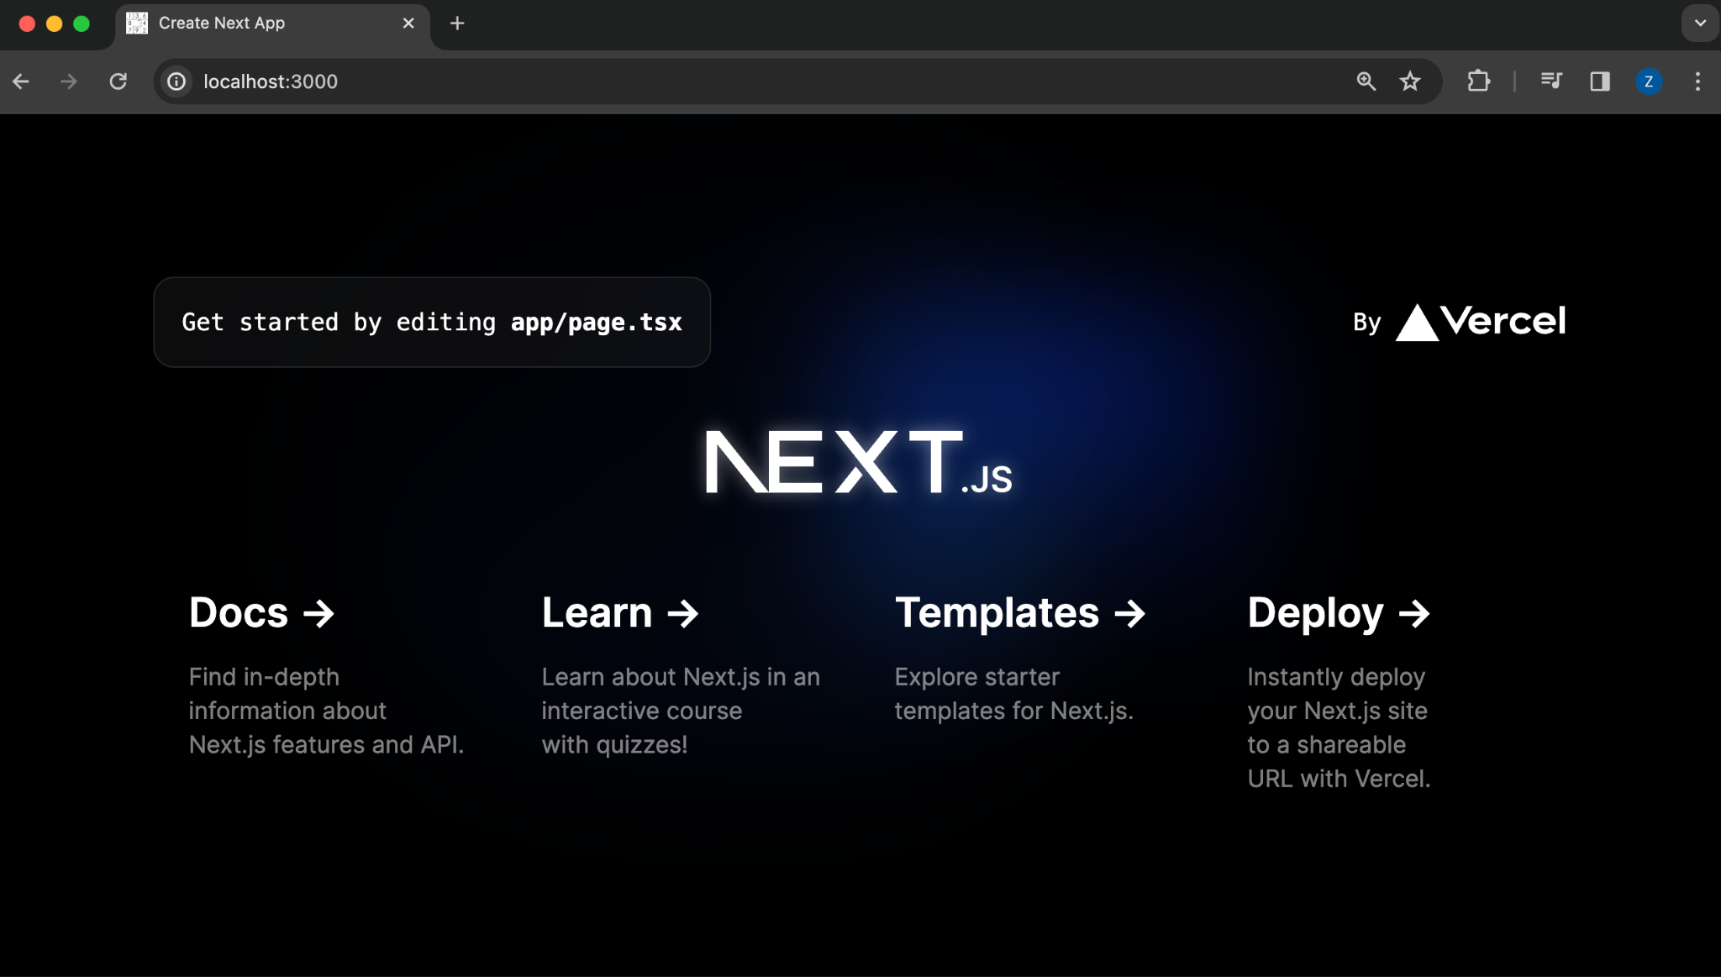

Slide 9
Tool Chain/Tech Stack - Zach
React via Next.js
Typescript back-end
Tailwind CSS front-end
Node for speed
NPM for building/running
Homebrew for package managing
Linode server

Slide 10
What’s Been Done?
Spoke with an experienced developer in the industry about web-apps.
Gained insight on how to approach our project and what tools to give thought to.
Installed NPM and Node for all members via Homebrew.
Learning a mix of Typescript, CSS, etc via tutorials.
Fixing installation and technical issues.
Established a Killer Sudoku web-app.

Slide 11
Next Two Weeks
Research More about TypeScript, CSS, NextJS, etc. (Nick & Drew)
Designing how the Sudoku Board will Function in code (Nick)
Consider possible solutions to creating grouped numbers. (Zach)
Render Sudoku board and clickable UI buttons. (Drew)
Communicating with Linode server and client requests via http. (Drew)
Work on ways to implement the timer. (Kevin)

Slide 12
OS & Meeting Time
Zachary
MacOS Ventura 13.5.1 M2, ZSH
Kevin
Windows 11, Ubuntu via WSL
Nick
Windows 10, Ubuntu via WSL
Drew
Windows 11, Ubuntu via WSL
Meeting Time:
Saturday - 3:30 PM

Slide 13
Grading Items

Slide 14
Contribution Summary
Nick
Successfully installed the necessary packages (but only on my desktop, not laptop though it doesn’t work)
Completed 2-3 slides
Attended our 2nd Meeting (Wasn’t present for the 1st, but read a summary of it)
Zachary
Installed vital packages for members & resolved technical issues regarding installation on various machines.
README.md and updated as needed.
Initialized Next.js, React components, ‘Hello World’ app, and package config.
Presented topics necessary for progress during meeting.
Drew
Researched webdev packages
Aided in installing packages for the team
Created Figma sketch of the application
Paid for and set up Linode server
Kevin Belock
Got the required packages installed on my pc
Learned how to build the project with NEXT
Read the first meeting summary and attended the second meeting to figure out what we would do next
Trying to help the group in anyway that I can.

Slide 15
Meeting Attendance
Meeting with IT Consultant
Present: Drew
Group Meeting (Checkpoint 1) 2/10/2024
Present: All members

Slide 16
Drew Mullett Contributions
Paid for and set up Linode Server
Met with IT professional Michael Spradlin to review best frameworks for our project
Found that React would be the best framework because it is popular for generating UI and has more resources available compared to the other options that we were more familiar with
Helped create Figma UI mockup
Helped teammates troubleshoot installing npm/nodejs

Slide 17
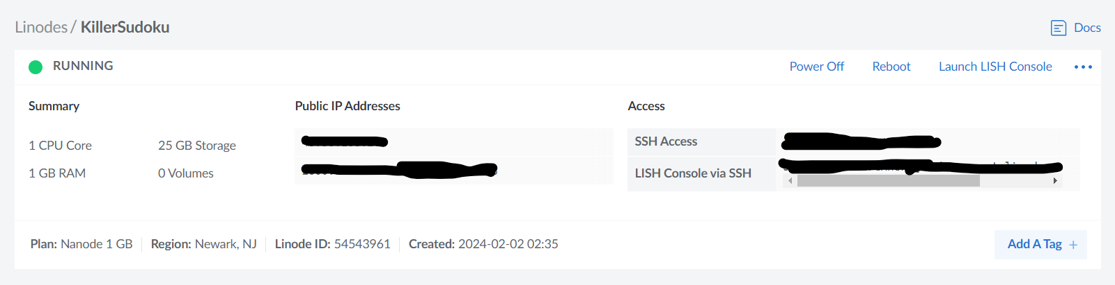
Drew Mullett Contributions - Evidence

Slide 18
Kevin Belock Contributions
Attended the first group meeting, being the second meeting.
Worked to get my computer ready to work on the project
Put some information on the slides.
Made sure to communicate with drew whenever I had a question
Slides I helped with as my evidence: Goals and Expected outcomes.

Slide 19
Nick Adkins Contributions
Worked with teammates to fix technical issues
Attended the group’s second meeting (2/10), and read a summary of the 1st
Regularly conversed with teammates online & in person to discuss how we are going to design & implement our project, and what languages/frameworks to pick & use.
Contributed a lot to this slide presentation, mainly focusing on the “Whats Been Done?” and “Next Two Weeks” slides, as well as my part in this slide & in the Contribution Summary

Slide 20
Zachary Wolfe Contributions
Initialized React app
Initialized Web-App icon
Installed packages to member’s machines
Debugged installation errors
Assisted in designing a presentable Figma mockup
Discussed roadblocks and possible solutions
Uploaded README.md and changed as needed
Learning Typescript
Contributed to multiple group slides

Slide 21
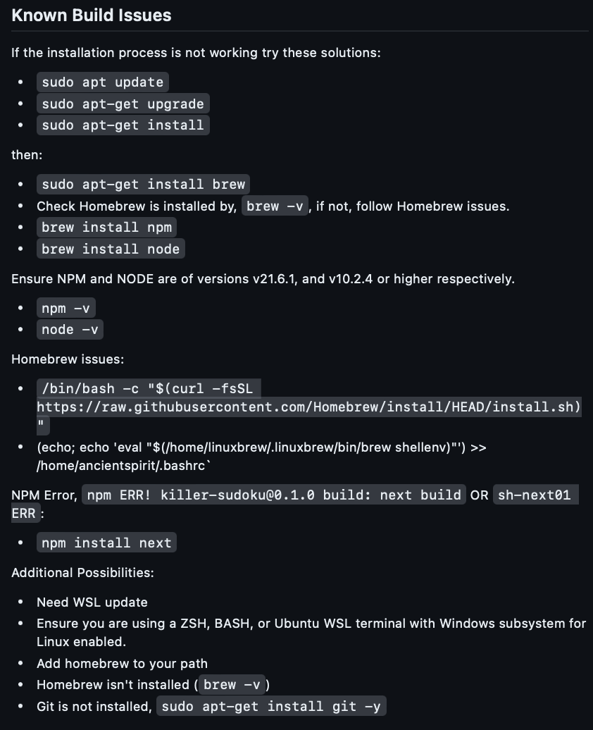
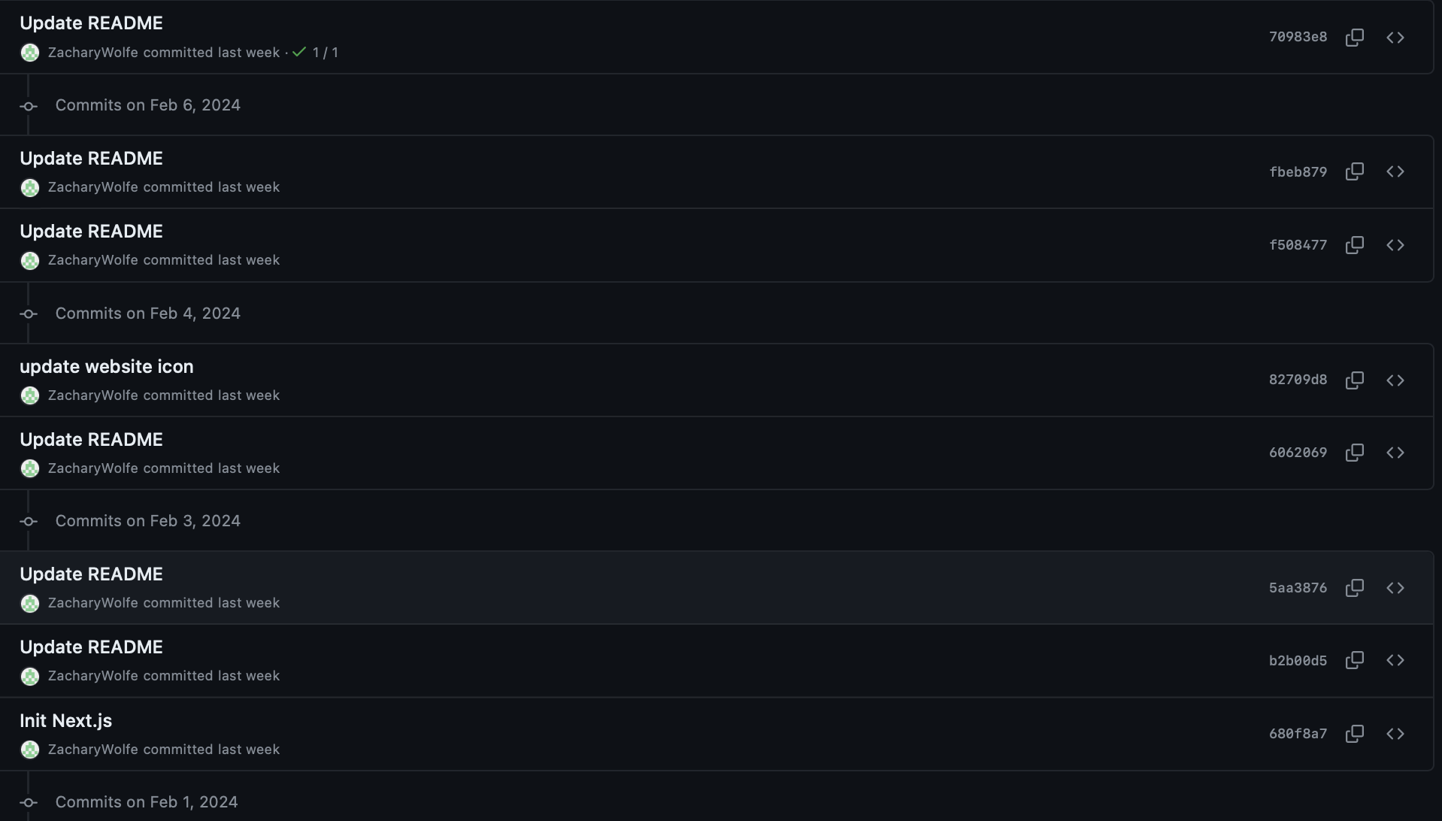
Zachary Wolfe Contributions - Evidence

Slide 22
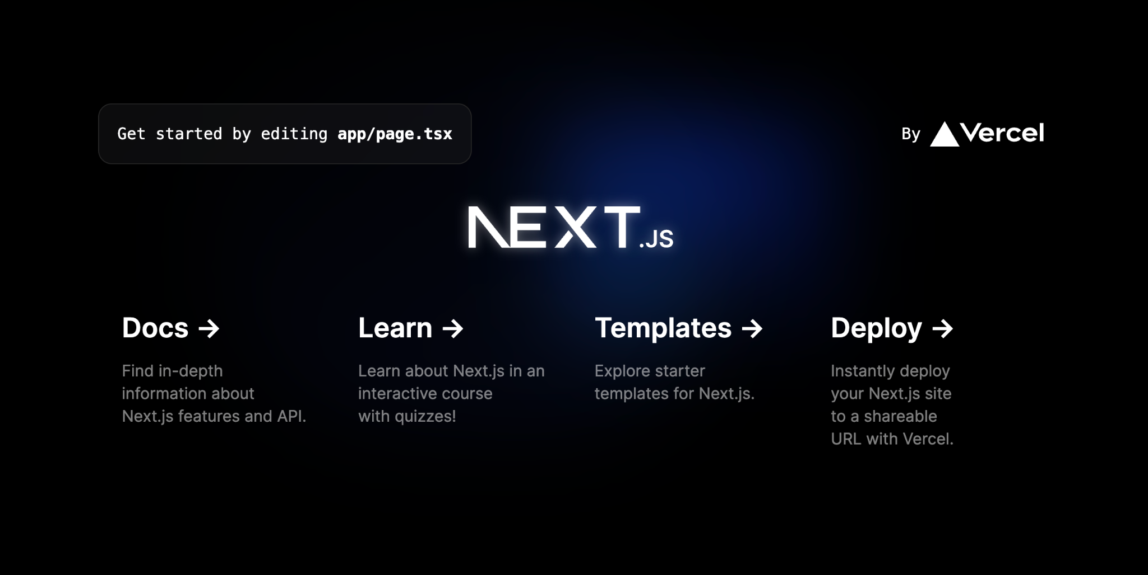
Zachary Wolfe Contributions - Evidence 2

Slide 23
Start of Checkpoint 2

Slide 24
Work Summary
Zachary
Permitted input to individual cells and legality for inputs (bounds, NaN)
Fixed input issues which would wipe the board to a default state
Removed an increment button for Form numbers on Chrome, Safari, Edge, and Opera browsers
Introduced many levels of shading, specific square, 3x3, row & col, non-highlighted, specific square but taken in row/col, non-specific square but taken in row/col
Logic for highlighting squares based on row/col inputs
Closed issue #11 (couldn’t see numbers beneath shading)
Closed issue #15 (read/write to a cell)
Styling of cells
Drew
Got our repo/React project onto my Linode server and made it publicly accessible from sudoku.drewmullett.net
Nick
Worked on board Generation, the Sudoku board now shows a randomly-generated valid Sudoku board
Added a Makefile, for convenience in running the program & quick version checking, among other things
Kevin
Went onto websites to find the best way to implement the timer and how to get it started
Started work on the timer code to get it to start counting how long you have been playing

Slide 25
Next Checkpoint Plan
Zachary
Fix highlighting, not complete and needs a rewrite
Solver implementation / UI
Highlight 3x3 borders separately (bolder) for better readability
Fix sizing issues with browser?
Drew
Get the server to host the website after closing the ssh connection
Aid Zach with remaining issues with coding the UI
Nick
Work on hiding x-number of elements on the board, depending on difficulty, so that it will be playable
This will probably require that I work on / add to the Solver
Kevin
Finish work on the timer code then talk with zachary to get it implemented into the UI for the game.
Talk to the team to see what else I can help with once The timer is implemented

Slide 26
Potential Roadblocks
Writing an algorithm to automatically group tiles together
Inputs from buttons vs. keyboard, most likely just input via keyboard

Slide 27
https://sudoku.drewmullett.net/

Slide 28
Grading Items

Slide 29
Contribution Summary
Nick
Worked on board Generation, the Sudoku board now shows a randomly-generated valid Sudoku board
Added a Makefile, for convenience in running the program & quick version checking, among other things
Zachary
Permitted input to individual cells and legality for inputs (bounds, NaN)
Fixed input issues which would wipe the board to a default state
Removed an increment button for Form numbers on Chrome, Safari, Edge, and Opera browsers
Introduced many levels of shading, specific square, 3x3, row & col, non-highlighted, specific square but taken in row/col, non-specific square but taken in row/col
Logic for highlighting squares based on row/col inputs
Closed issue #11, #15
Learning more TSX, CSS
Contribution to slides
Styling of cells
Drew
Introduced teammates to GitHub’s issue and branch features
Got webapp up and running on sudoku.drewmullett.net
Read tutorials on Typescript/CSS
Kevin Belock
Researched the implementation of a timer
Worked on coding in the timer for Sudoku.

Slide 30
Meeting Attendance
Group Meeting (Checkpoint 2) 2/24/2024
Present: All members

Slide 31
Drew Mullett Contributions
Introduced teammates to GitHub’s issue and branch features
Got code up and running on sudoku.drewmullett.net
Set up a local repository on the Linode server so I can easily pull the current version of the webapp
Read tutorials on Typescript/CSS

Slide 32
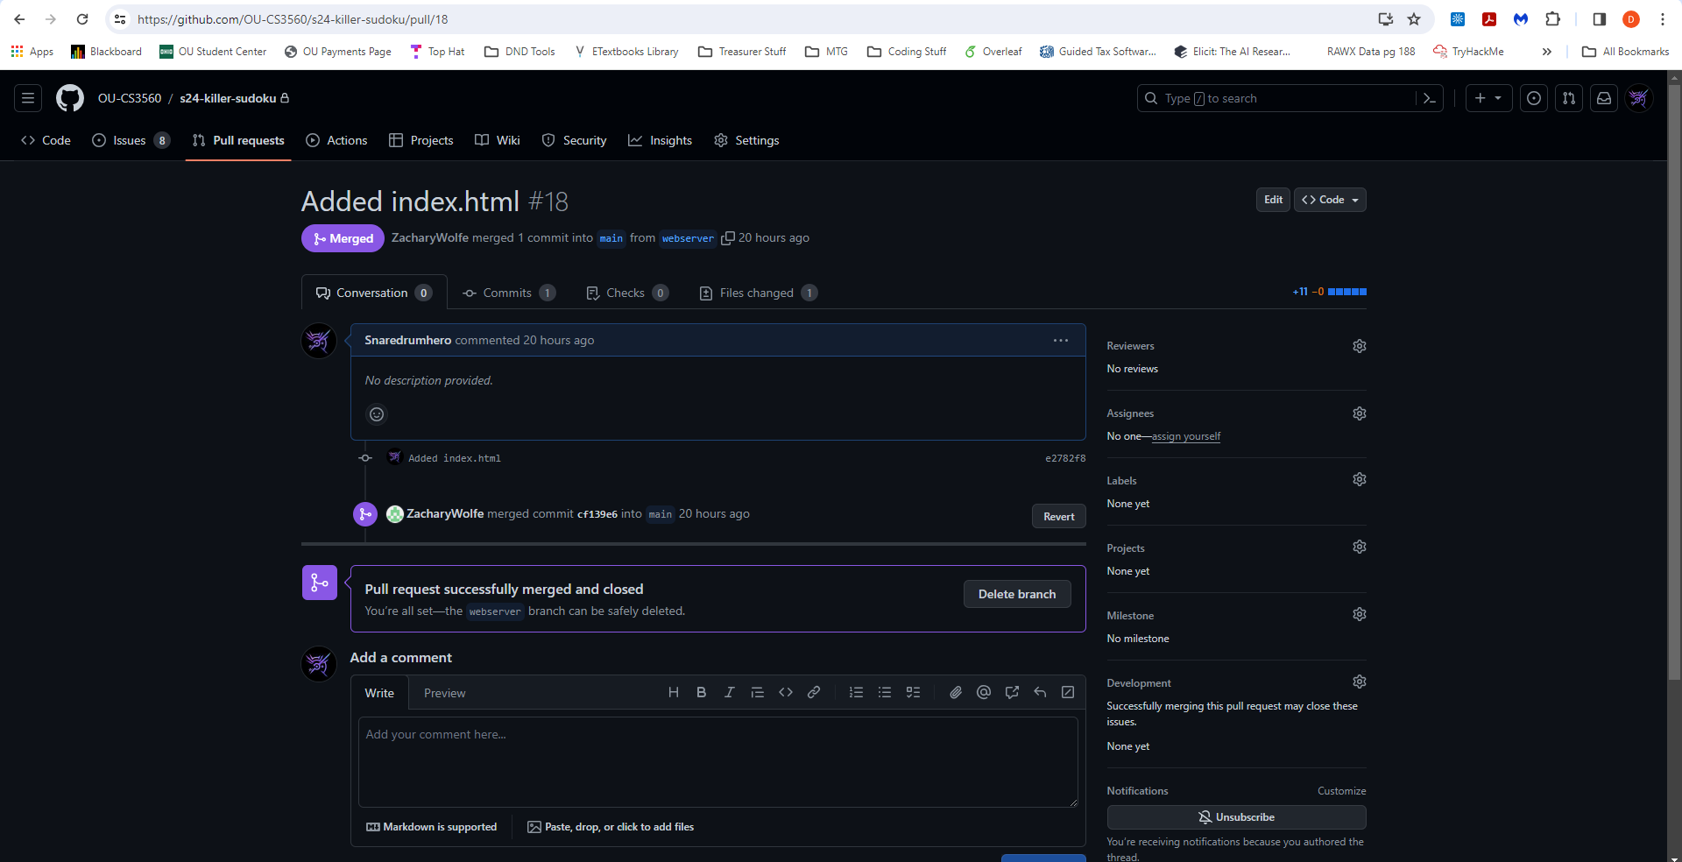
Drew Mullett Contributions - Evidence

Slide 33
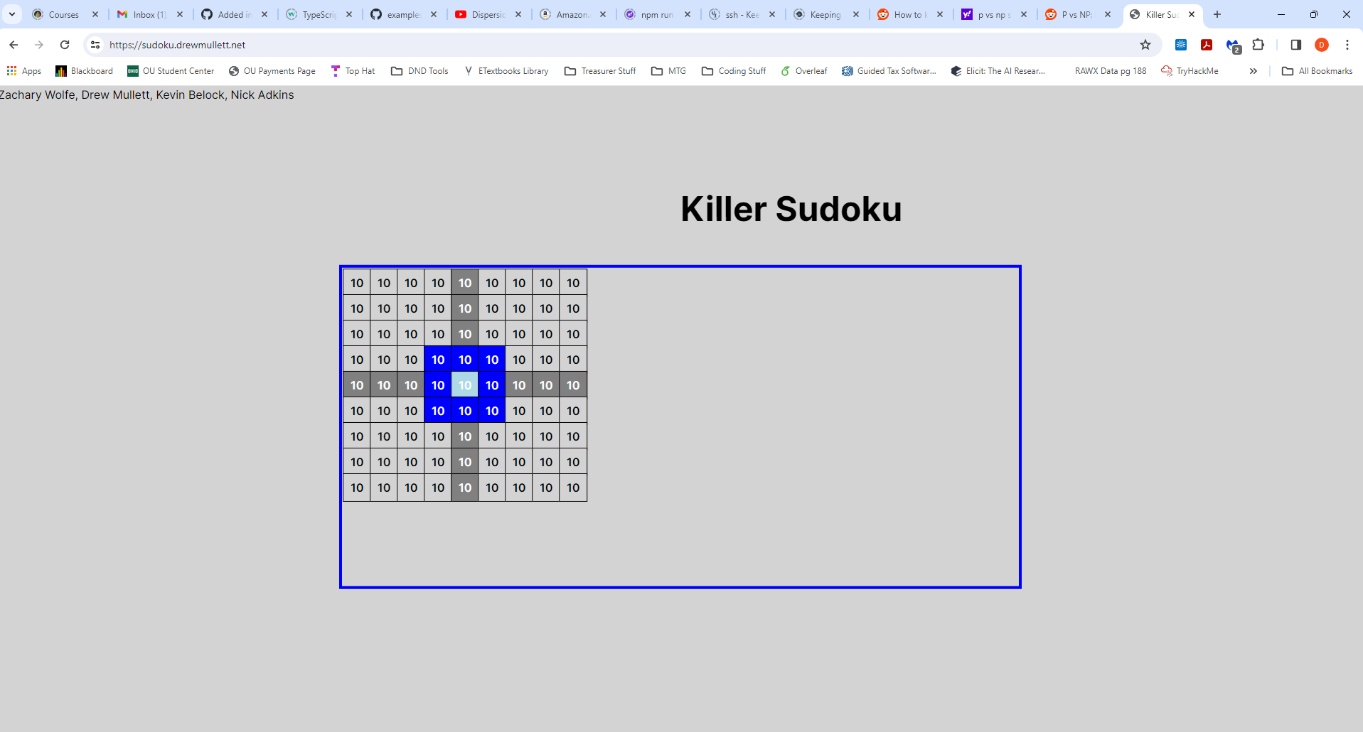
Drew Mullett Contributions - Evidence (cont.)

Slide 34
Zachary Wolfe Contributions
Introduced 2d array of cells
Submitted many issues to Github
Permitted input to individual cells and legality for inputs (bounds, NaN)
Fixed input issues which would wipe the board to a default state
Removed an increment button for Form numbers on Chrome, Safari, Edge, and Opera browsers
Introduced many levels of shading, specific square, 3x3, row & col, non-highlighted, specific square but taken in row/col, non-specific square but taken in row/col
Logic for highlighting squares based on row/col inputs
Closed issue #11, #15
Learning more TSX, CSS
Contribution to slides
Styling of cells
Maintenance of repo and PR’s
Assisted teammates in resource gathering and gradual learning

Slide 35
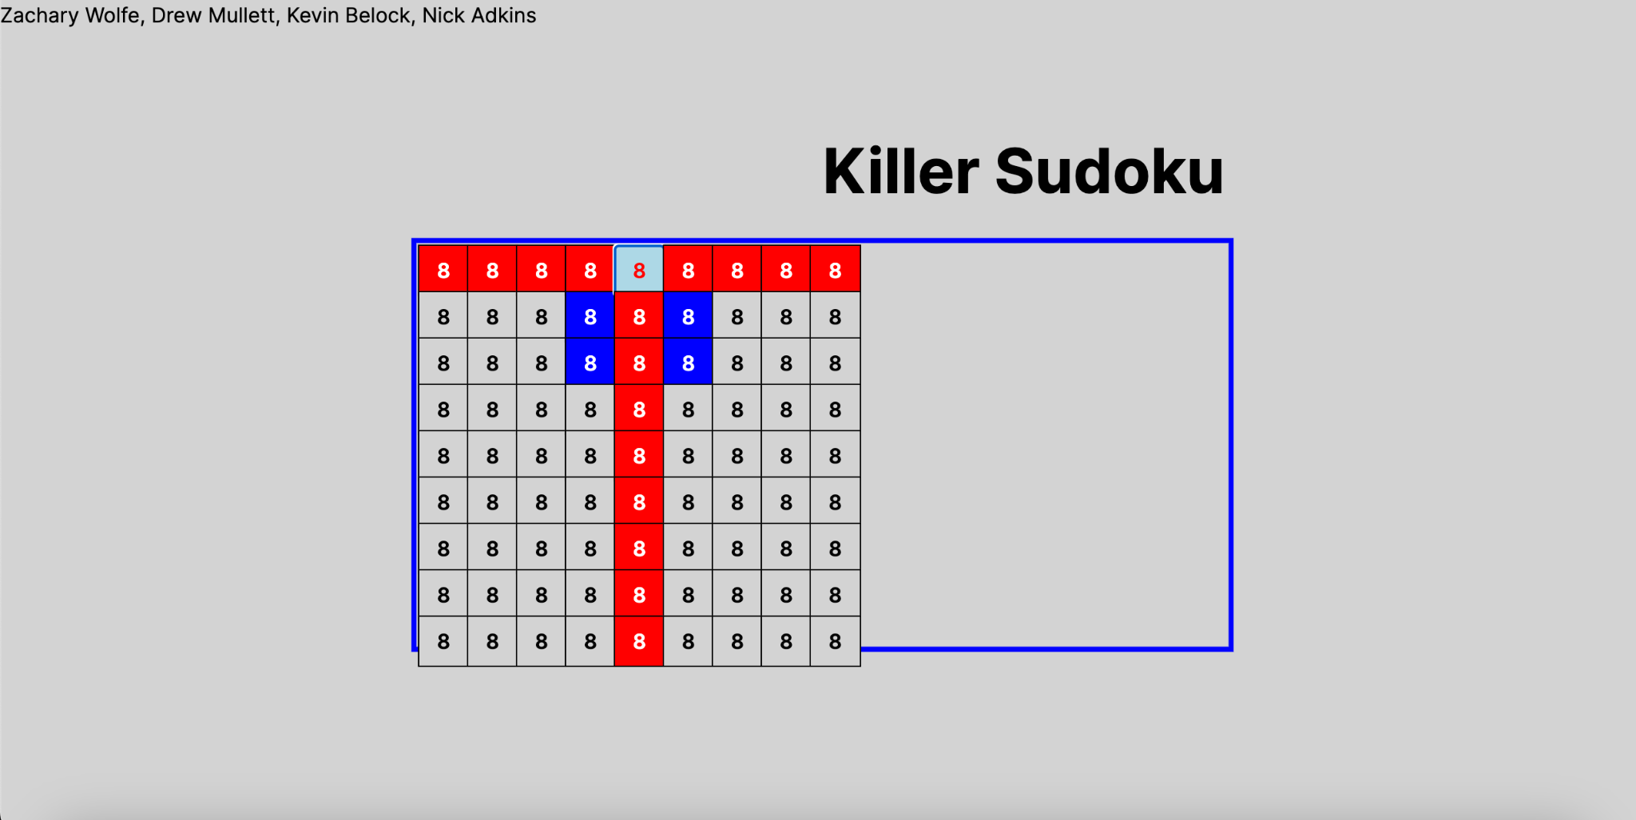
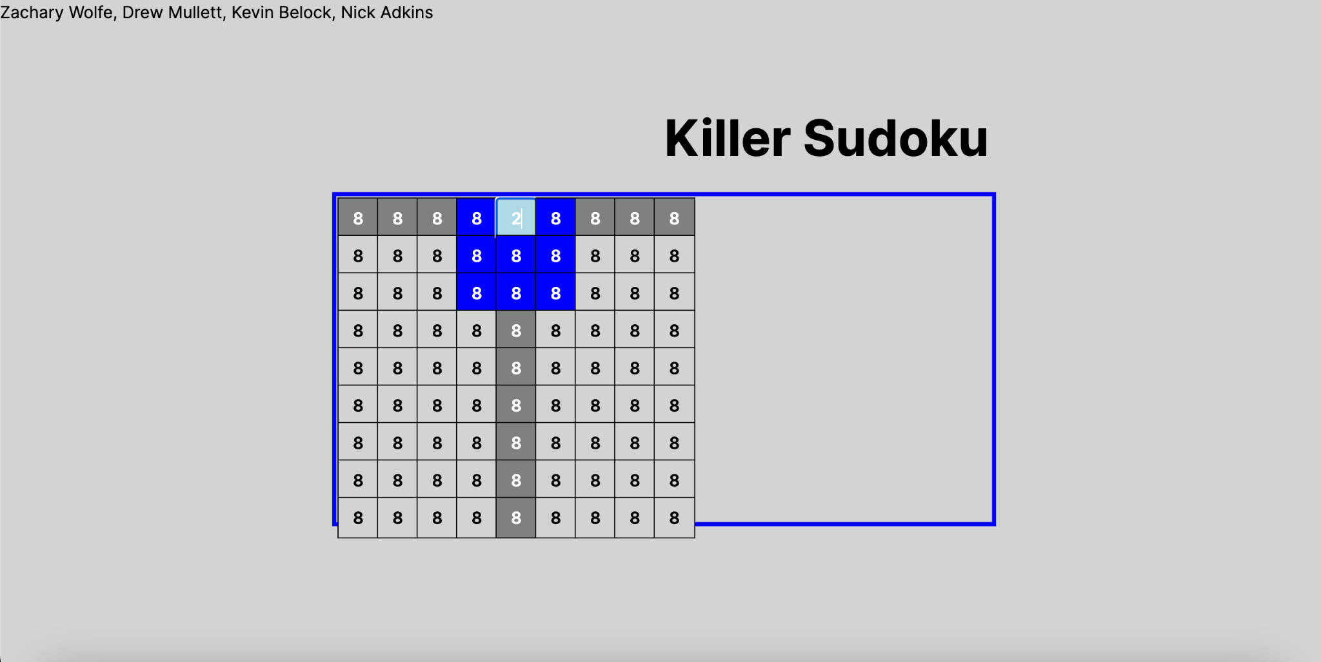
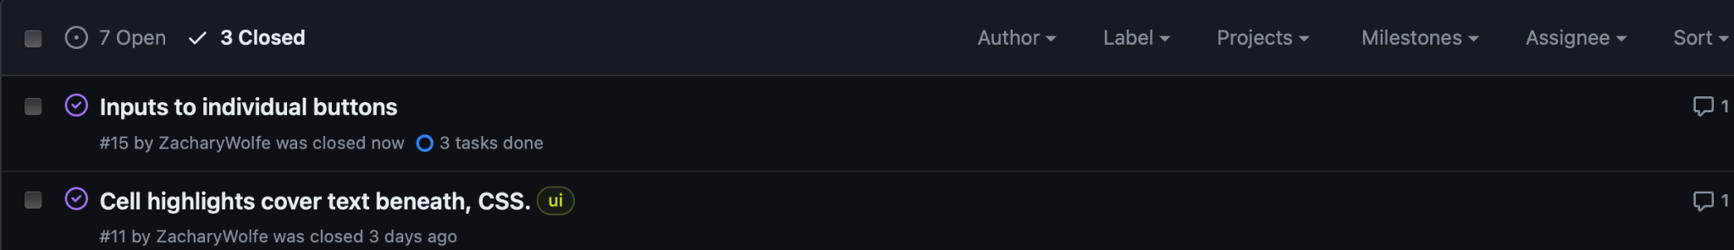
Zachary Wolfe Contributions - Evidence

Slide 36
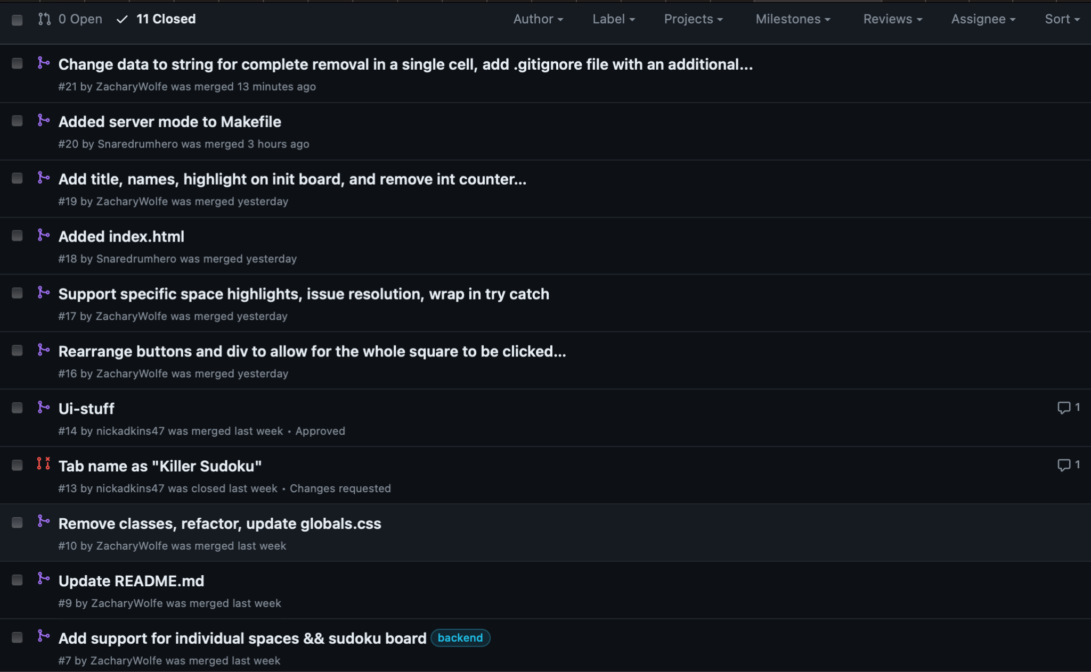
Zachary Wolfe Contributions - Evidence cont.

Slide 37
Nick Adkins Contributions
Worked on board Generation, the Sudoku board now shows a randomly-generated valid Sudoku board
Added a Makefile, for convenience in running the program & quick version checking, among other things

Slide 38
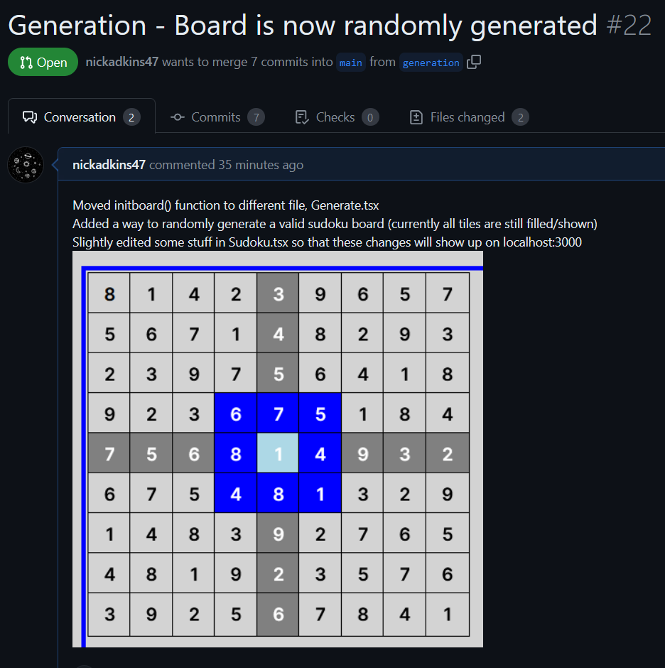
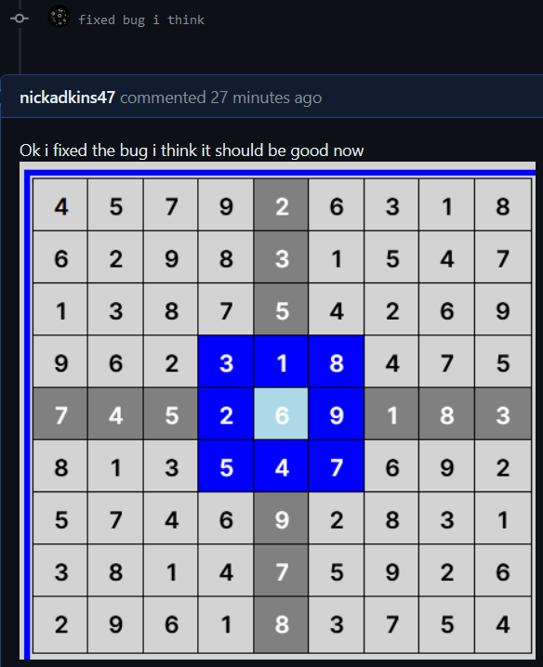
Nick Adkins Contributions - Evidence

Slide 39
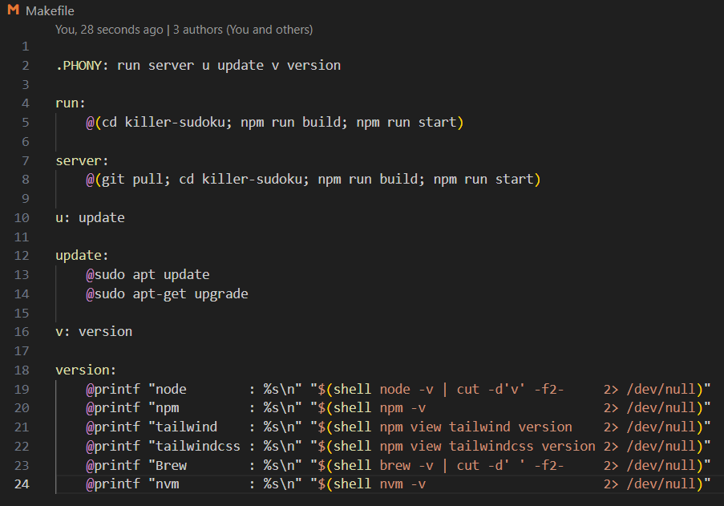
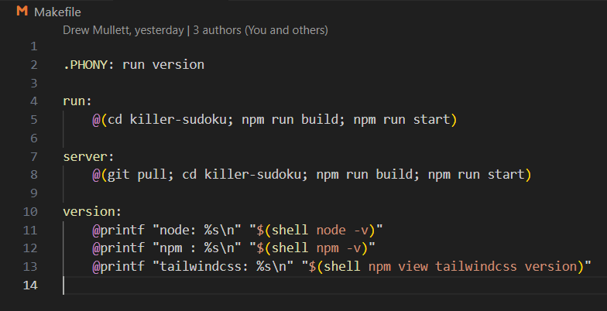
Nick Adkins Contributions - Evidence cont.
Updated Makefile (Ui-stuff Branch)
Makefile (Main Branch)

Slide 40
Kevin Belock Contributions
Researched how the best way to implement the timer would be through react
Have started programming the timer though not fully implemented yet, I have pushed what I have to the Timer branch on github.

Slide 41
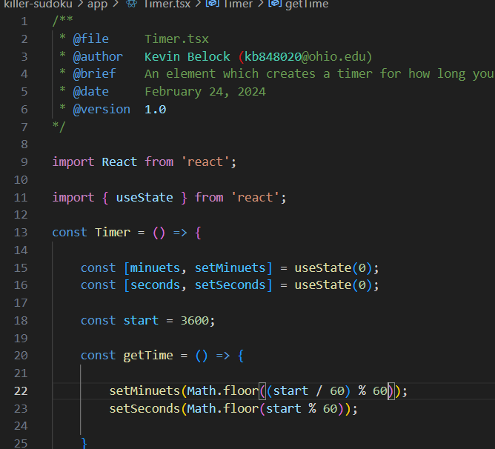
Kevin Belock Contributions - Evidence

Slide 42
Start of Checkpoint 3

Slide 43
Meeting Attendance
Group Meeting 3/5/2024
Present: All members
Group Meeting 3/16/2023
Zachary, Drew, Kevin
Group Meeting (Checkpoint 3) 3/19/2024
Present: All members

Slide 44
Work Summary
Zachary
Reworked Timer to add support for instancing a timer on a board.
Linked Timer to cell clicks and pause/start button.
Pause button stops timer, resume by button or pressing on board.
Completed UI highlighting for the last time.
Added a ‘New Game’ button and number Panel.
Added navbar for pathing.
Added bolded border outline on board.
Added Google API icons to support an intuitive UI.
Fixed browser resizing.
Closed Issue #12, #1, #31.
Drew
Added functionality for server to make HTTP GET request along with difficulty selecter.
Created pathing segments for sudoku and killer sudoku.

Slide 45
Work Summary (cont.)
Nick
Added function to Solve the sudoku board (Mostly works, but still WIP)
Completely Reworked the Generation Algorithm to be more random, at the cost of time efficiency (of which is still barely noticeable: a time of 0.2 ms VS ~30 ms to generate a board)
I just recently optimized the algorithm from ~30 ms → ~20 ms
Reworked tile showing system so that the resulting board is always compatible with the solver function
Closed Issue #2
Kevin
Finished the base template for the Timer
Researching how to implement the cages for a Killer Sudoku board.
Made a list of progress to go through to slowly build the necessary components for the cages of Killer Sudoku.

Slide 46
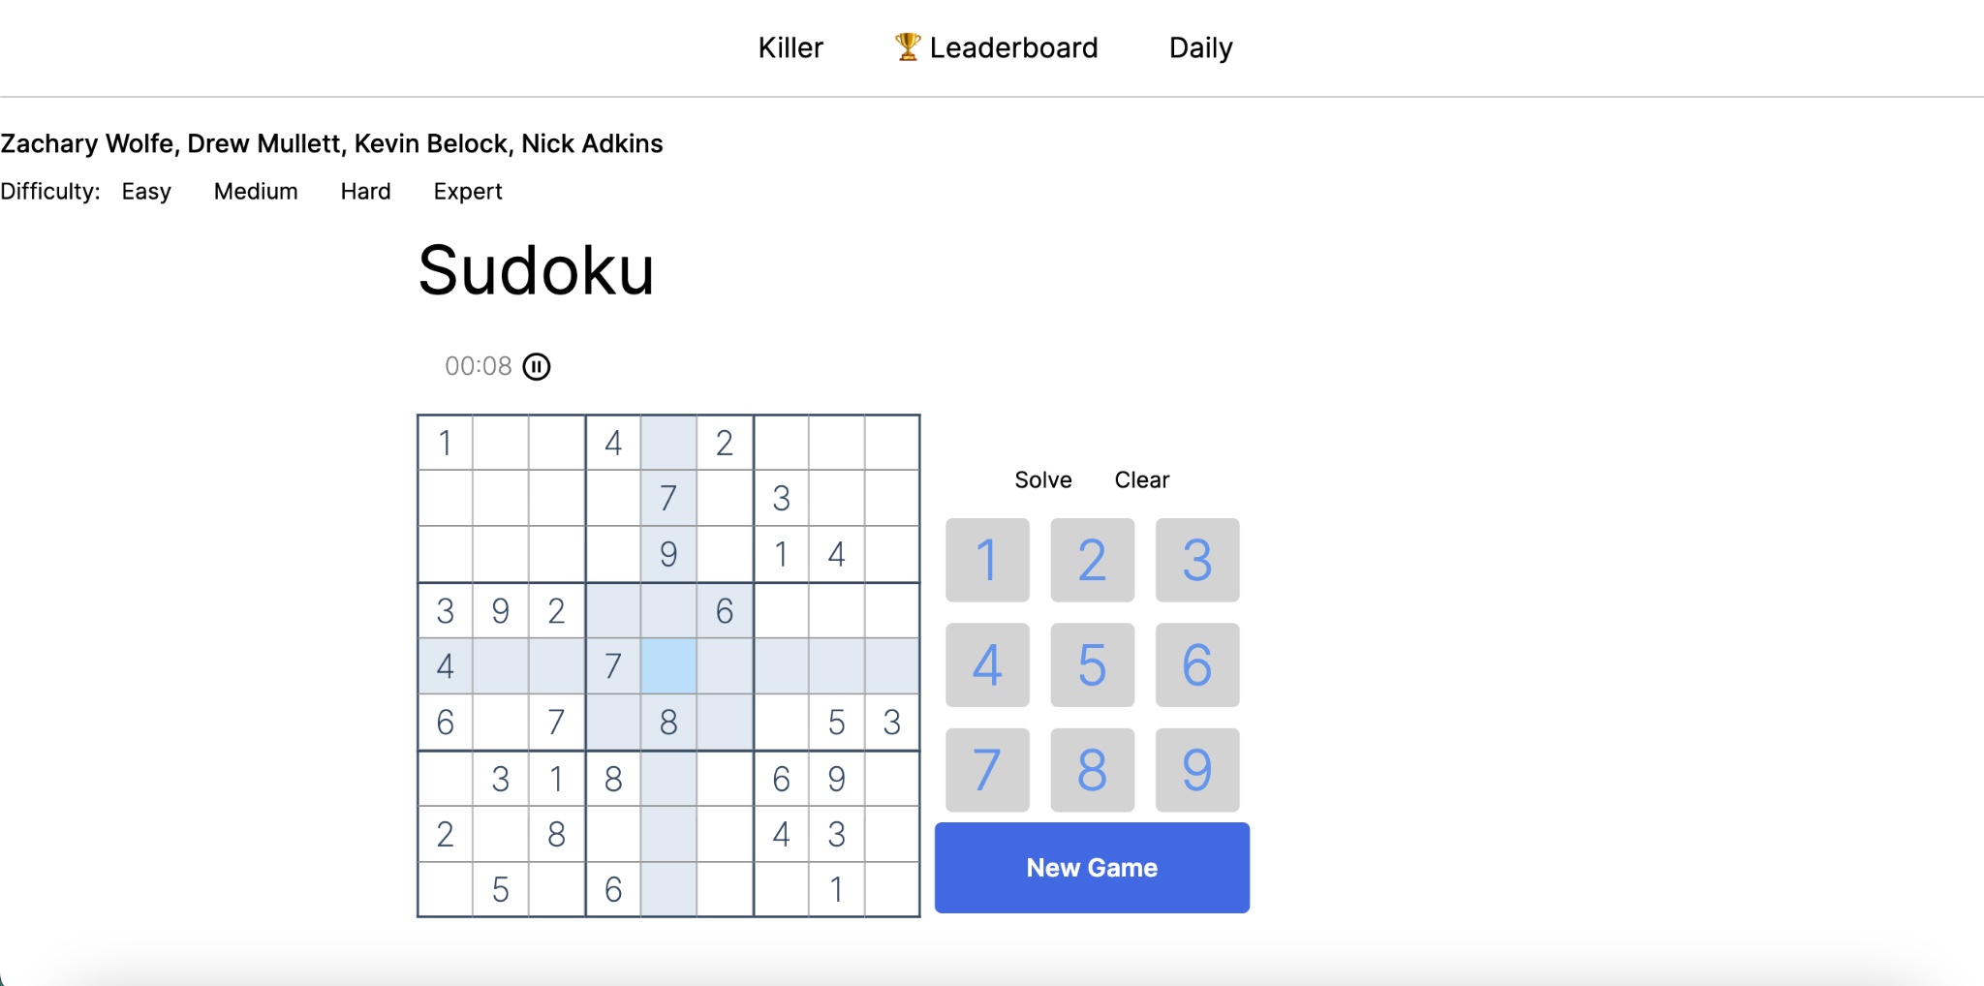
Comparison
Checkpoint 3
Checkpoint 2

Slide 47
Next Checkpoint Plan
Zachary
Adjust highlighting algorithm to disregard clicks onto the same cell without any change which will in turn adjust panel clicks so that the algorithm can find which cell to change the number in.
Start on dashed borders, cell groupings, and placing numbers in the top left of certain cells.
Add an Erase button.
Count mistakes the player has made.
Authenticating users.
Create page for leaderboard & choose database.
Game ending
Drew
Implement server interception of GET & POST requests.
Encode Sudoku puzzle into JSON and decode it into a Sudoku puzzle object.
Nick
Implement the backend part of the Tile Notes system
Add a lot more stuff to the solver algorithm
Help with the backend part of the Killer Sudoku Groupings
Fix bug in Solve button (it doesnt solve correctly if there are incorrect tiles)
Kevin
Work on implementing the sudoku cages

Slide 48
Road Blocks
Zachary
Finding the previous cell you clicked on for panel, search for it using two for’s?
Drew
How to properly encode the information into a json format that would make sense
How to separate sudoku and killer sudoku generation
Nick
How killer sudoku groupings are gonna be generated (Thinking about what is the best way to do this)
Kevin
Getting the cages to not overlap with each other and generating the shapes of the cages
Designing the shapes and how to do highlighting / marking the different groups.

Slide 49
Toolkits
GitHub
Doxygen Generation VSCode ext
Chrome Dev Tools
Docker
IDEs: VScode, NVIM
Figma, websequencediagrams.com
Firebase - Authentication / (Storing users?)
Tailwind CSS, React TSX

Slide 50
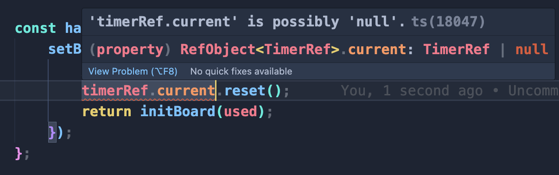
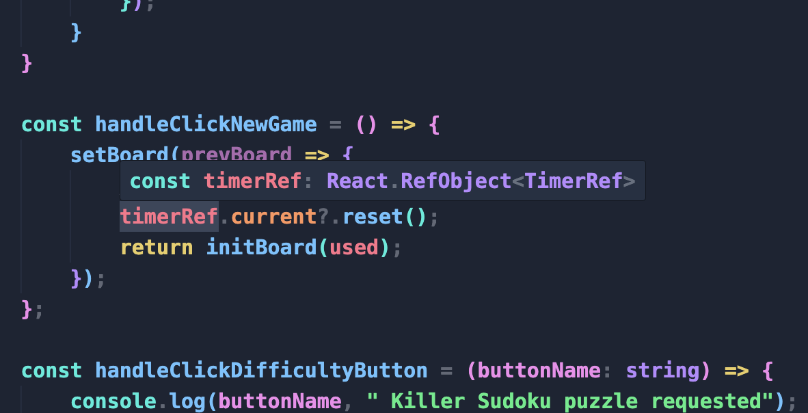
Zachary Wolfe Static Analysis
Microsoft React Native Tools
NPM
We all use these tools, but I don’t use the other tools that my teammates do because I feel that they’re unnecessary and if you write code you should know what it’s doing without needing a program to tell you what it’s doing.
The issues encountered for all of the code I wrote were intentional because it’s base code for the next feature I plan to implement. Haven’t fixed analysis issues in my code because the code is boilerplate for the next feature.

Slide 51
Kevin Belock’s Static analysis
The tool I used was Esplint. It was a tool shared to all of the team members to use
The issues it recorded is where a variable is assigned and never used, saying to use different variable types when no variable is recorded. The variables assigned but not used might affect the performance with how much memory that could be wasted in not taking care of them, same as making some variables consts would improve their security.
I did not fix any issues as all of the issues that were recorded were found on my team partners parts of the project. I was researching how to implement the sudoku grouping for the killer sudoku board.

Slide 52
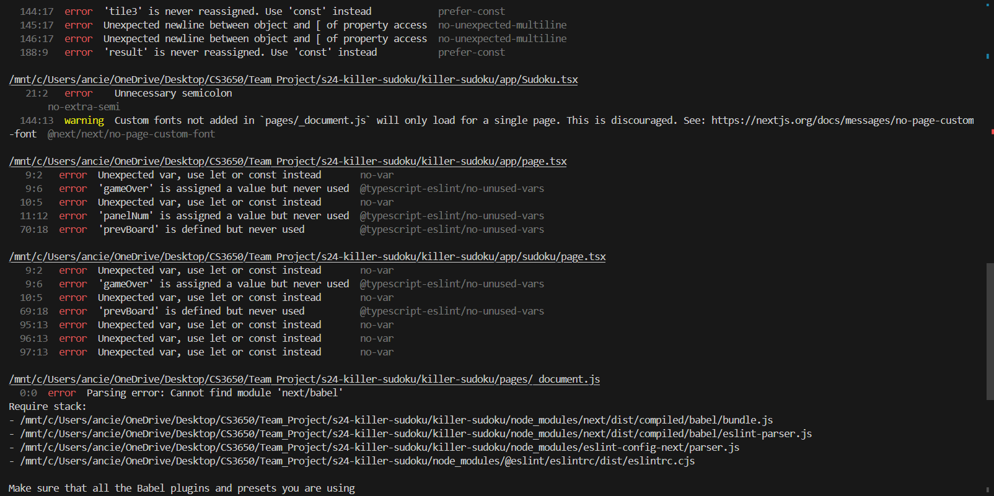
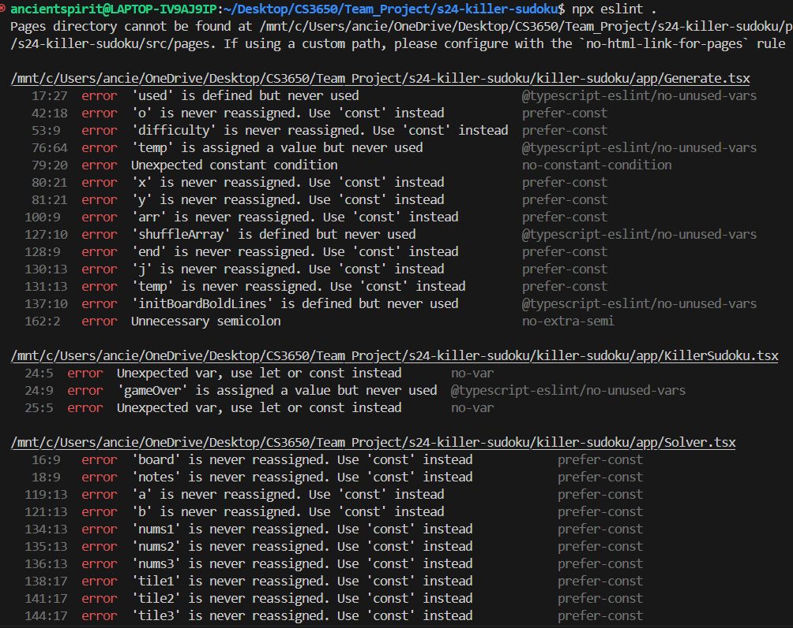
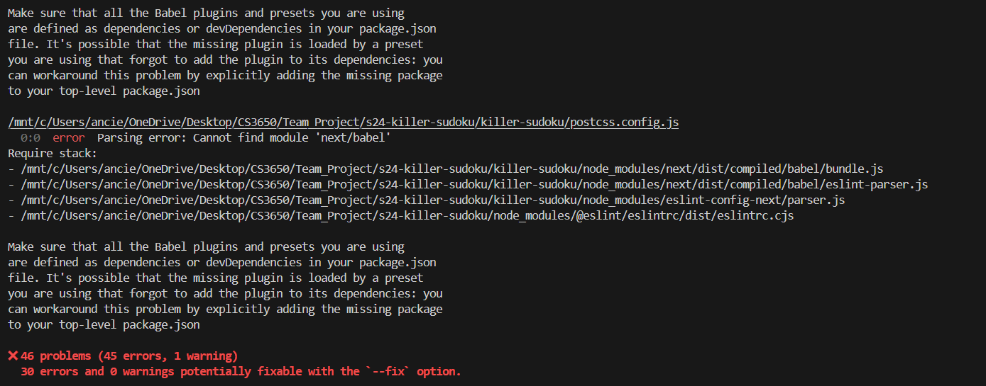
Kevin Belock’s Static analysis cont.

Slide 53
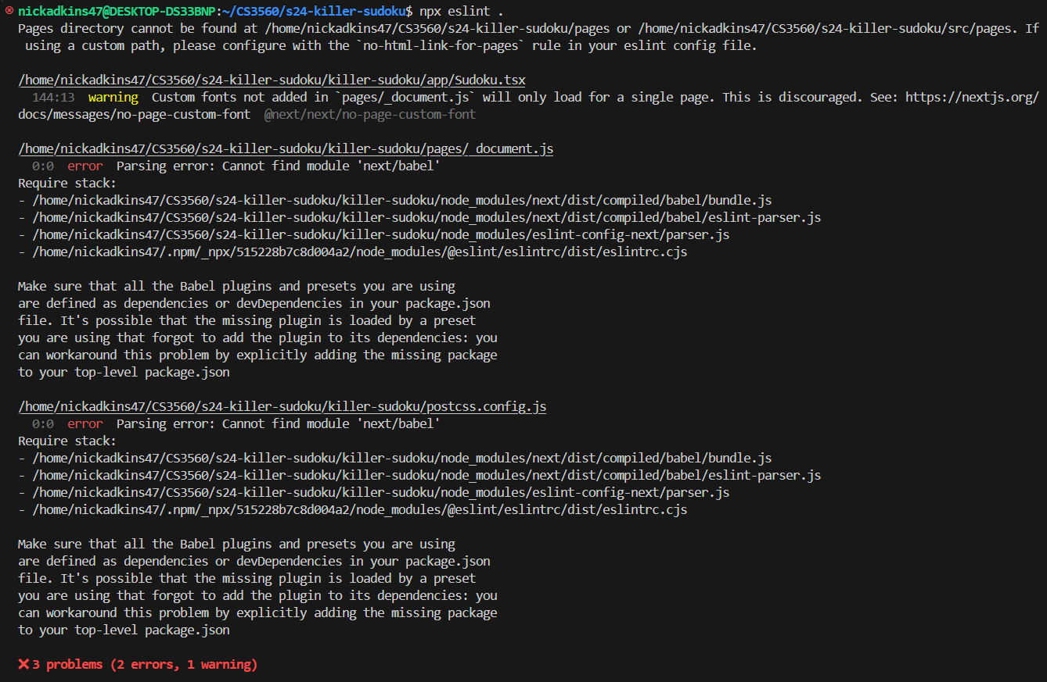
Nick Adkins Static Analysis
Thus far, i’ve only used ESLint & used it to check the main directory, found 2 errors & 1 warning. As of now, this is all i’ve done with Static Analysis.

Slide 54
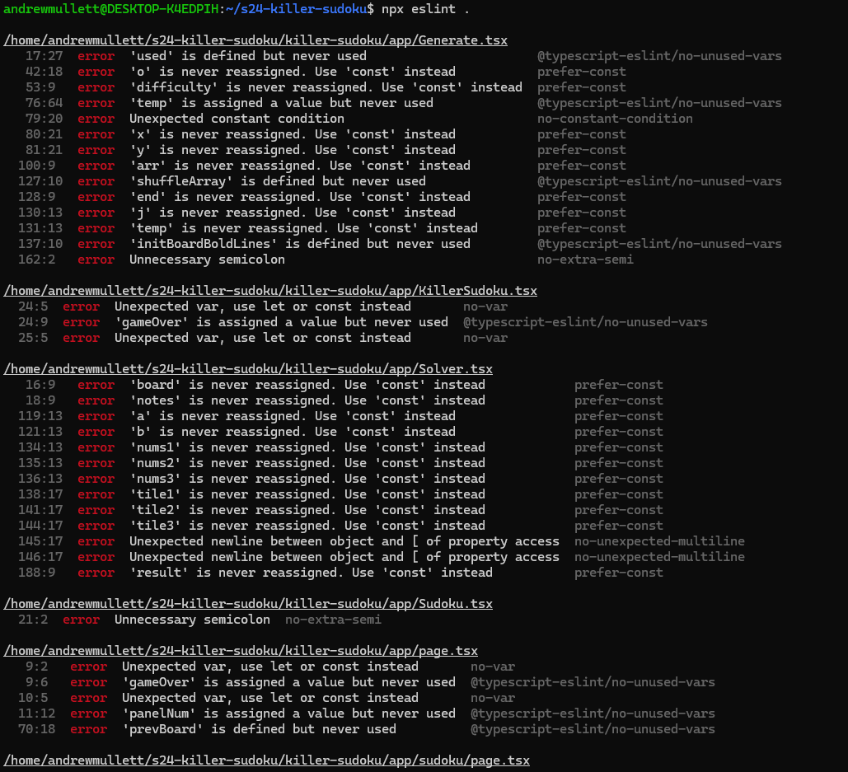
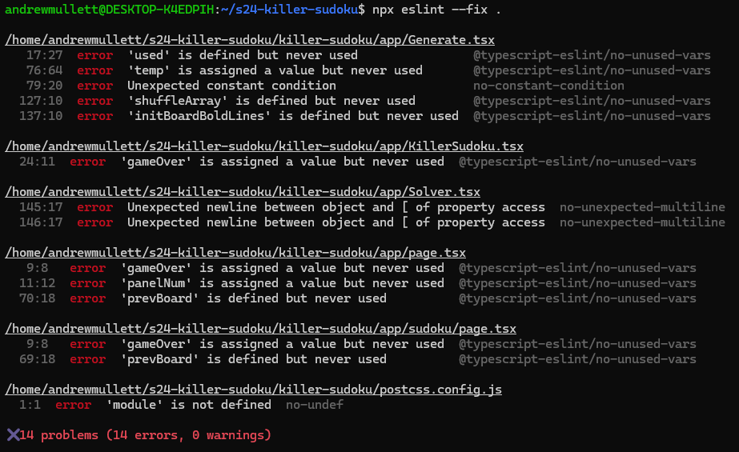
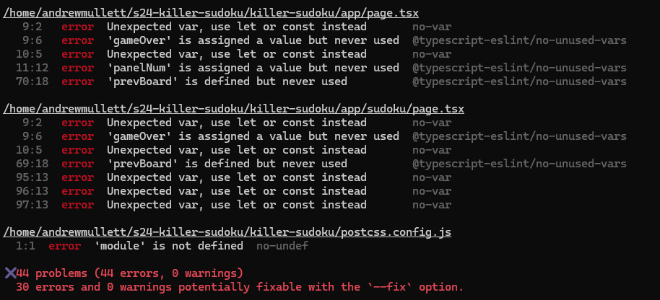
Drew Mullett Static Analysis
Before fixes
After fixes

Slide 55
Drew Mullett Static Analysis
Had a few errors with defining editable variables when it was not strictly necessary (i.e. using let instead of const). After updating the code, I’ve made a PR to have the team review it to make sure I’m not papering over important aspects of other people’s code

Slide 56
Zachary Wolfe Contributions
Improved performance by removing keystroke inputs re-highlighting the entire board
Installed package for rerouting and was working on this for a few weeks until a better solution was provided by drew
Fixed up Timer, added support for instancing a timer on a board
Linked the timer to cell clicks
Pressing the pause button stops the timer, resume by pressing anywhere on the board
Fixed UI highlighting for the final time
Added a ‘New Game’ and Button Panel
Added navbar
Added bolded border outline
Added Google API icons to support an intuitive UI
Fixed browser resizing
Closed Issue #12, #1, #31

Slide 57
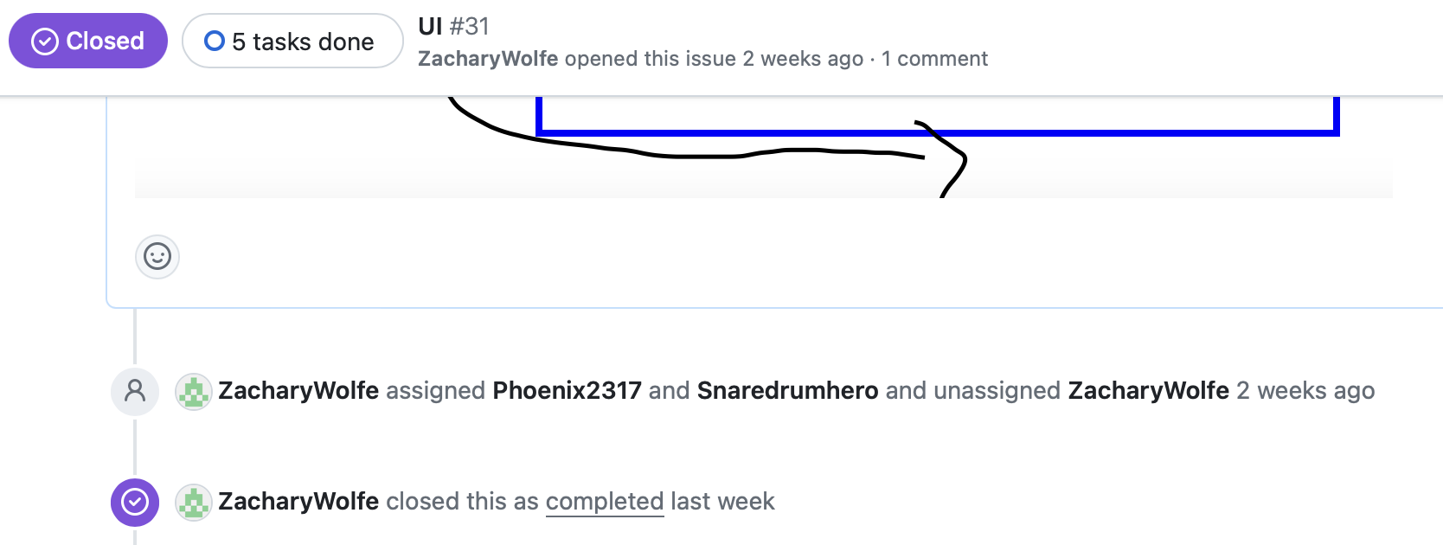
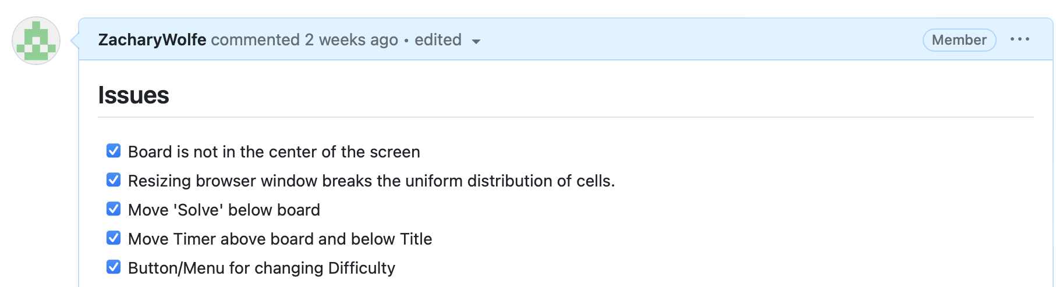
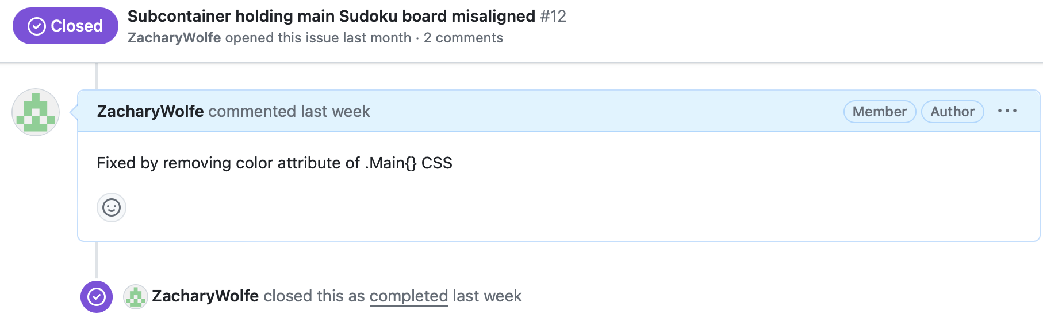
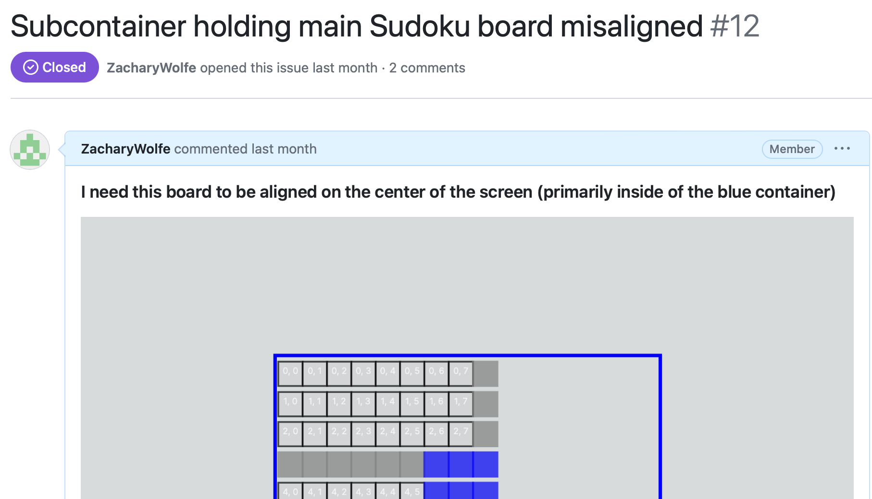
Zachary Wolfe Contributions - Evidence

Slide 58
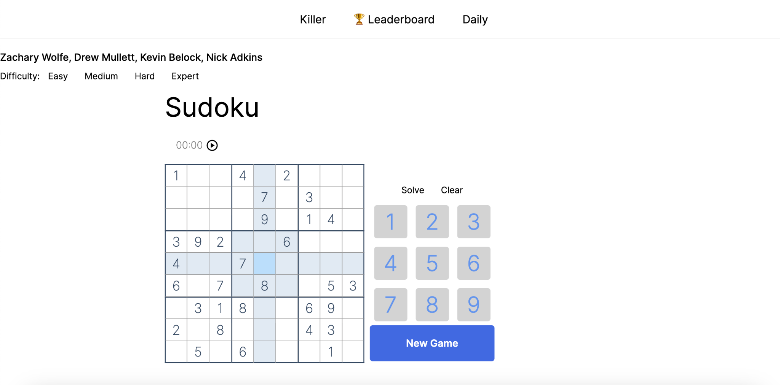
Zachary Wolfe Contributions - Evidence cont.
Navbar
Panel
New Game
Bold outlines
Buttons hover
Timer start-stop
Changed whole
layout of website
to support intuitive UI

Slide 59
Drew Mullett Contributions
Added functionality for server to make http GET request along with difficulty options
Created site segments for sudoku and killer sudoku
Created Dockerfile for project

Slide 60
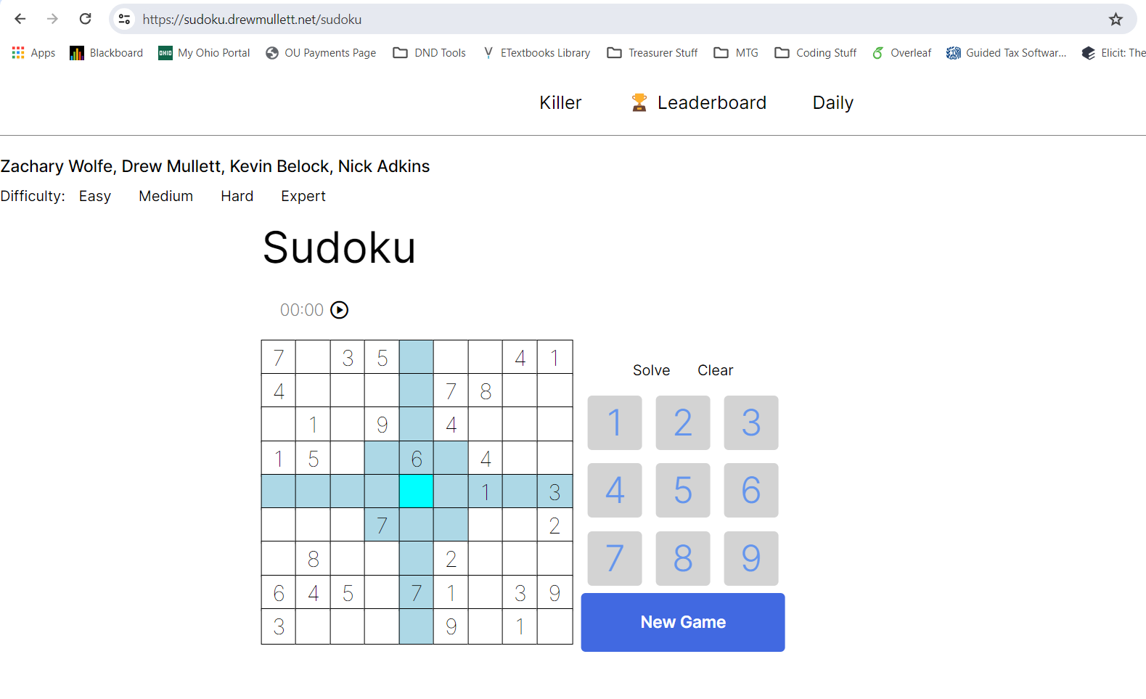
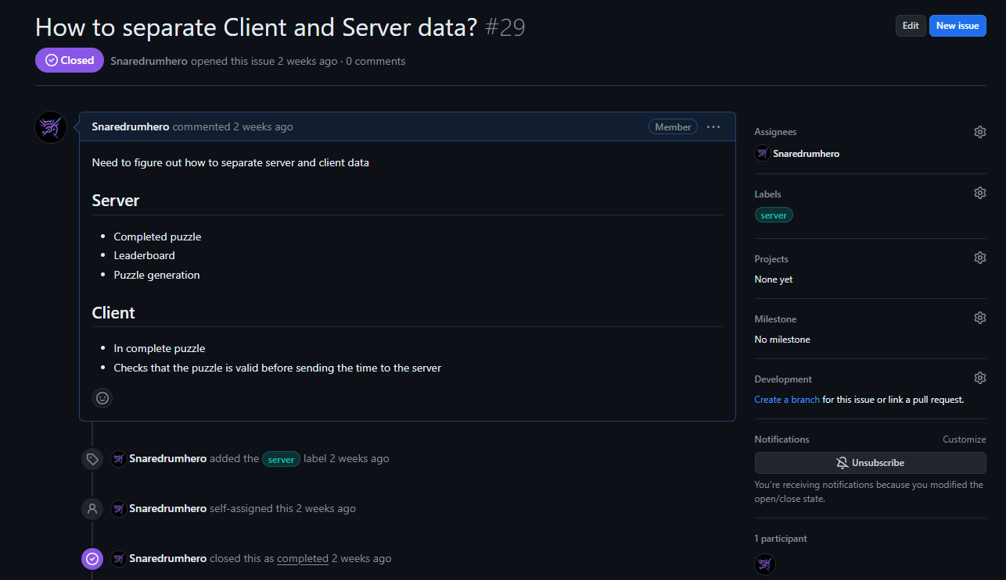
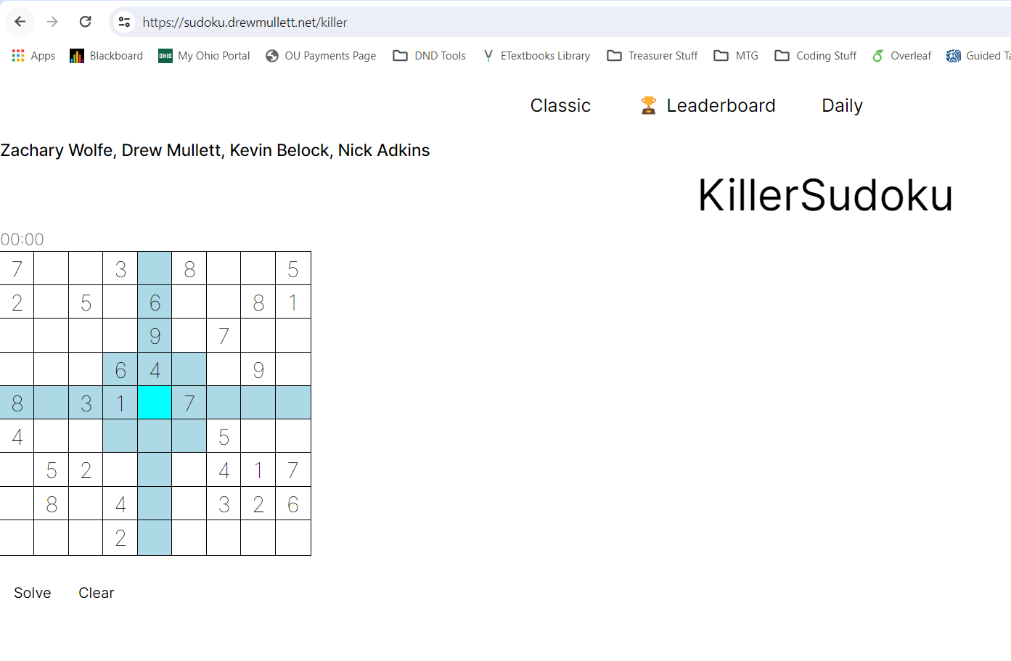
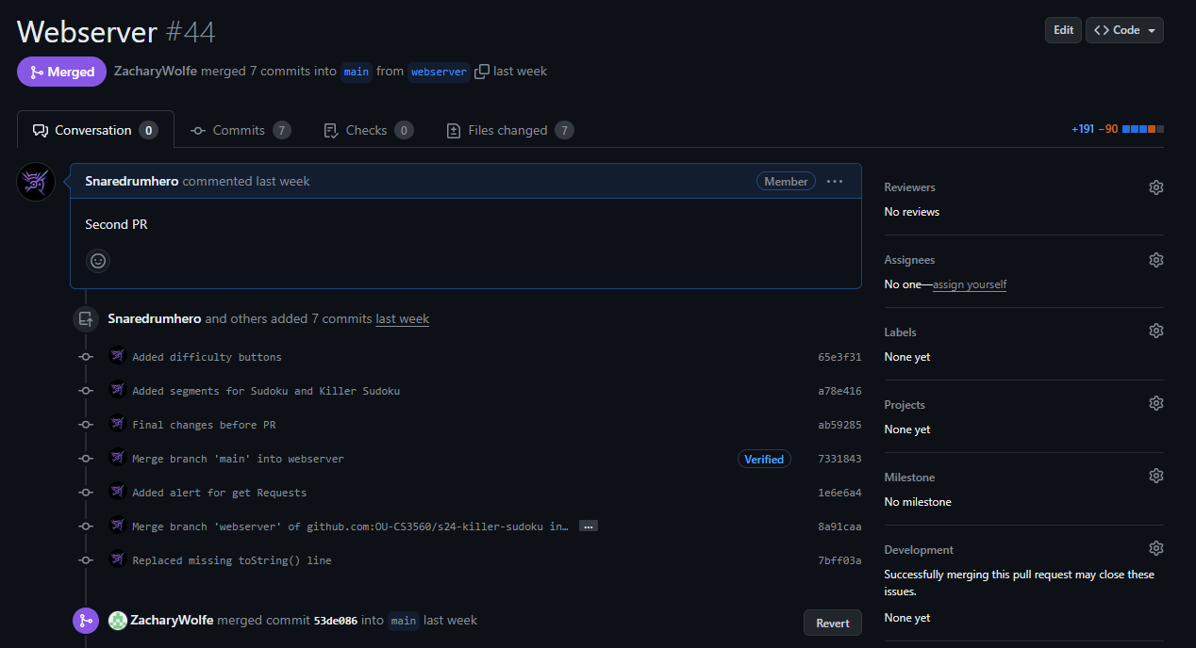
Drew Mullett Contributions - Evidence

Slide 61
Nick Adkins Contributions
Added function to Solve the sudoku board (Mostly works, but still WIP)
Completely Reworked the Generation Algorithm to be more random, at the cost of time efficiency (of which is still barely noticeable: a time of 0.2 ms VS ~30 ms to generate a board)
I just recently optimized the algorithm from ~30 ms → ~20 ms
Reworked tile showing system so that the resulting board is always compatible with the solver function
Closed Issue #2

Slide 62
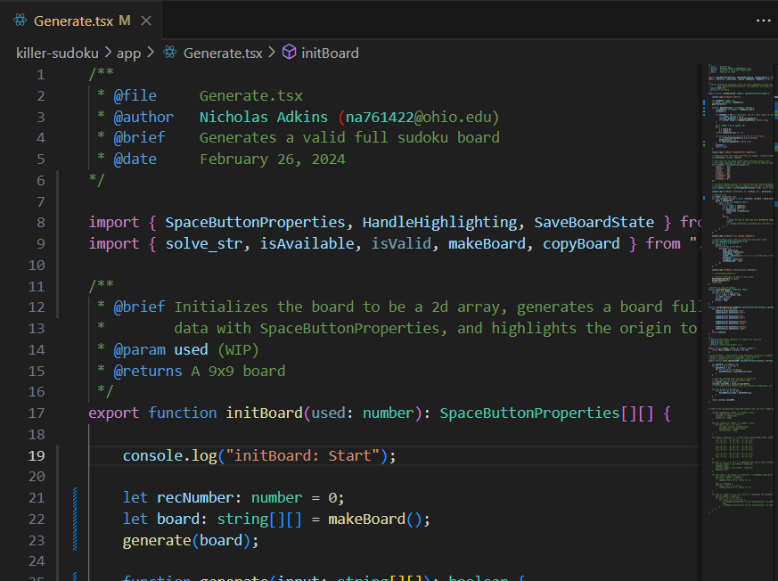
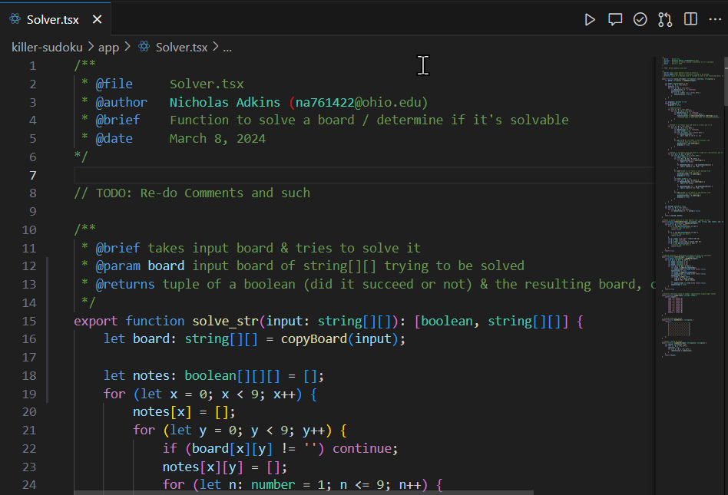
Nick Adkins Contributions - Evidence
(Both Generate.tsx & Solver.tsx are now about 200 lines each, can't show all of it here)

Slide 63
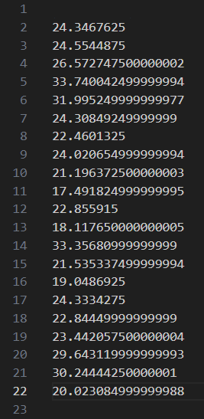
Nick Adkins Contributions - Evidence (cont.)
I Copied over my code into a test file, and logged the time it took to generate the board (using the performance.now() function).
Post-Optimization: I output the average time (ms) of 40 generation attempts, repeated 20 times, into a text file, as seen on the right. I don't have an image of what the numbers were Pre-Optimization, but they were higher, around 30 ms or so.
Note: These numbers were from my desktop; it generates a bit slower on my laptop

Slide 64
Kevin Belock’s contributions
I researched ways to implement the cage / grouping for the killer sudoku side of the board. The hardest thing to make will be implementing the shapes and outlining them properly without any overlap.

Slide 65
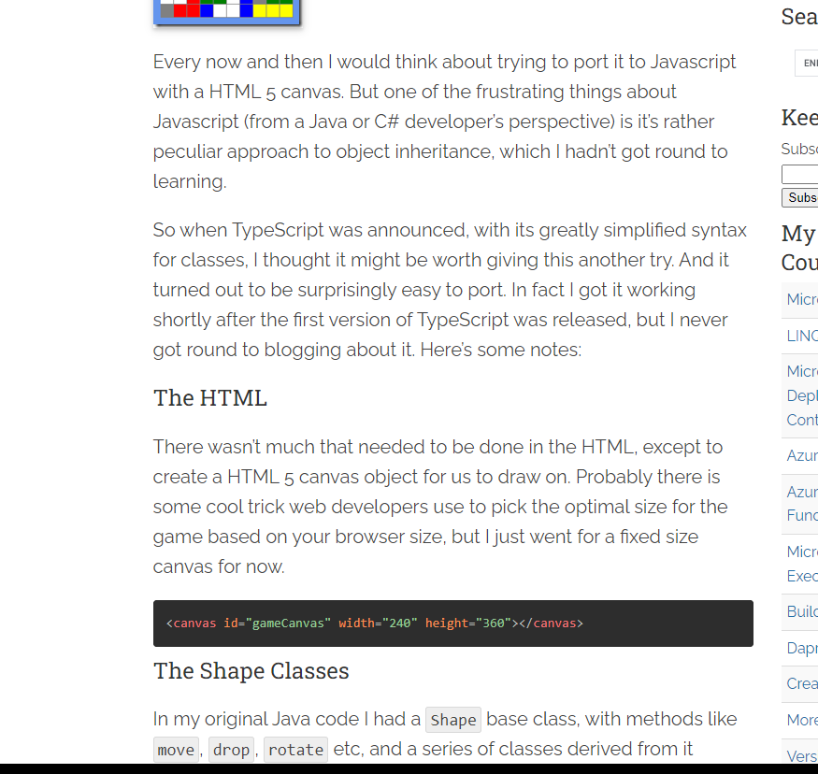
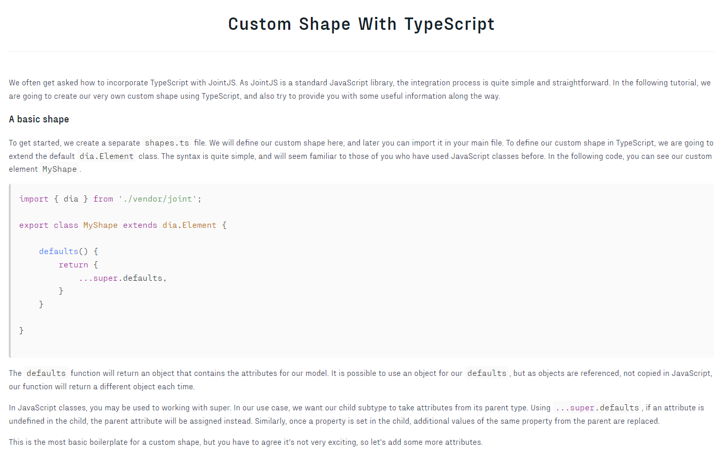
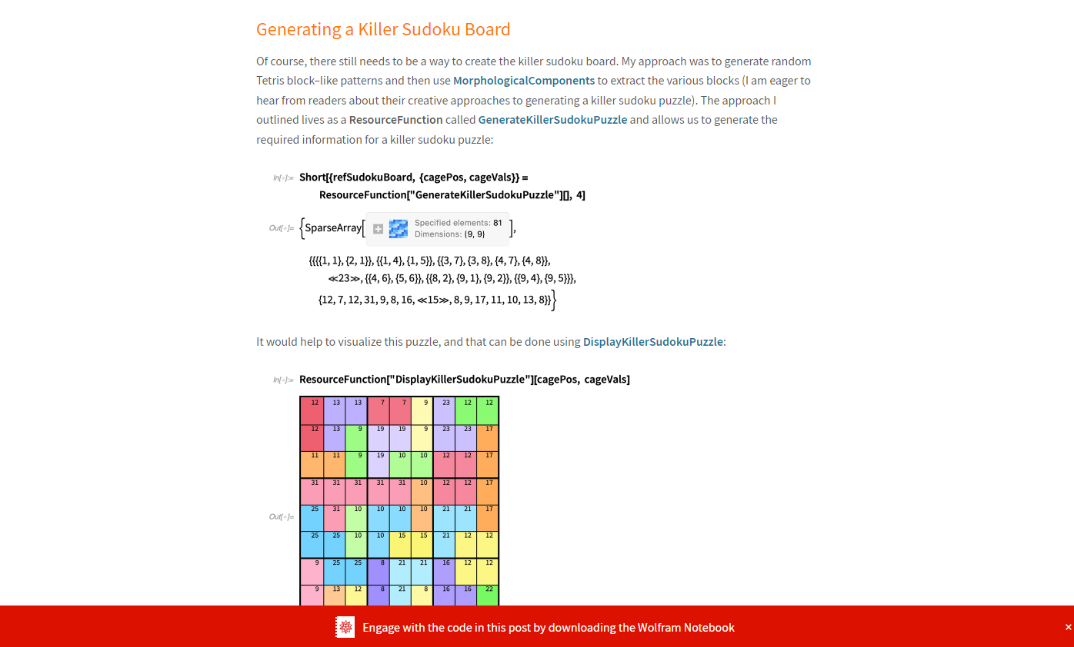
Kevin Belock’s contributions evidence
Websites I have visited for research;
https://markheath.net/post/typescript-tetris
https://resources.jointjs.com/tutorials/joint/tutorials/ts-shape.html
https://blog.wolfram.com/2020/06/02/using-integer-optimization-to-build-and-solve-sudoku-games-with-the-wolfram-language%C2%A0/

